Slide 1
Stress Management Application
Team : Avengers

Slide 2
What is Stress Management Application
A bot to engage people with some sessions on physical activities like yoga and have fun with each exercise to reduce stress anxiety.
Users can see Images or Youtube links that are added for the exercises.

Slide 3
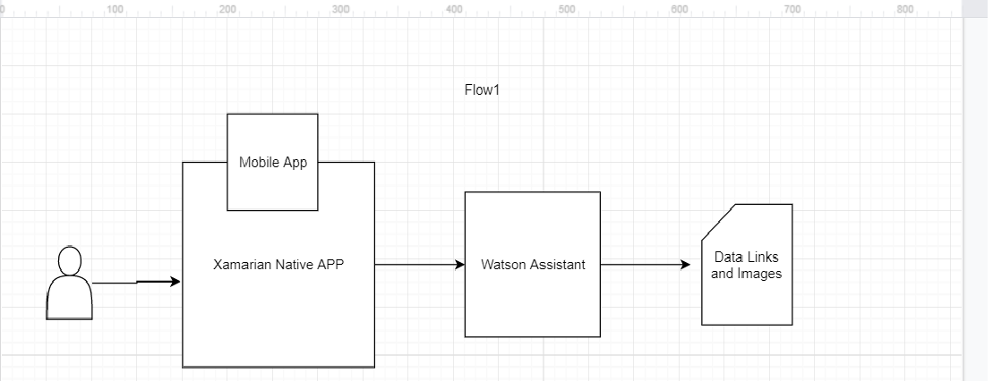
Current Architecture:
IBM Watson assistant is used for building the chatbot.

Slide 4
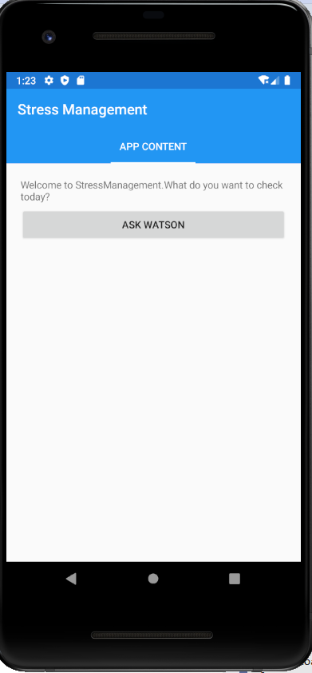
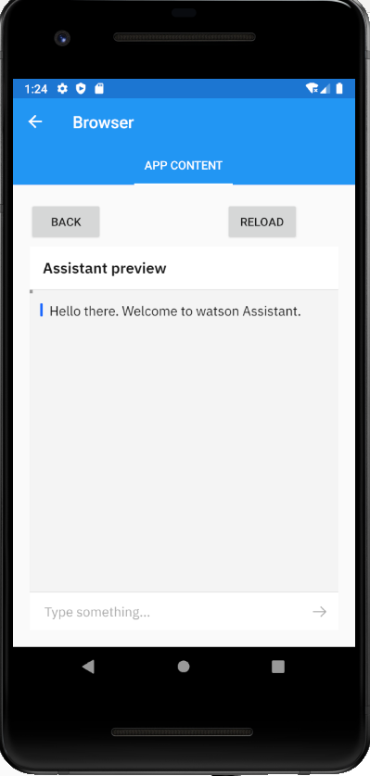
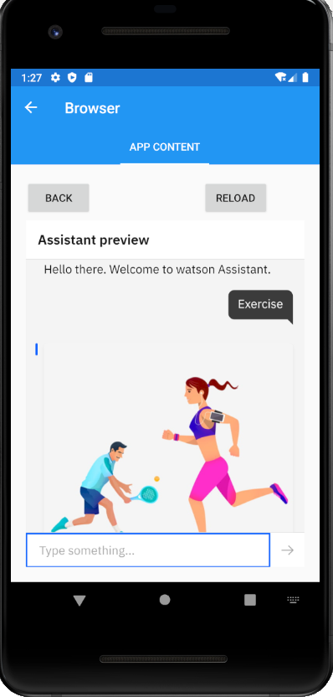
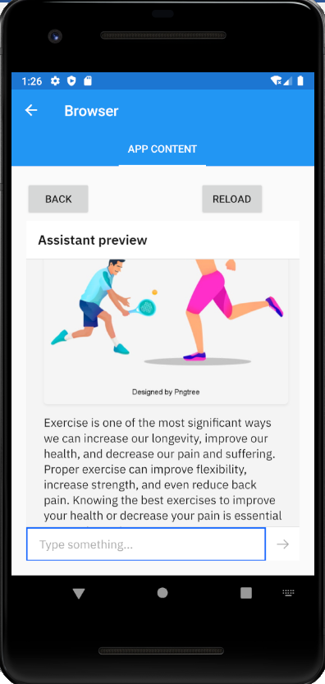
How Chatbot Works :

Slide 5
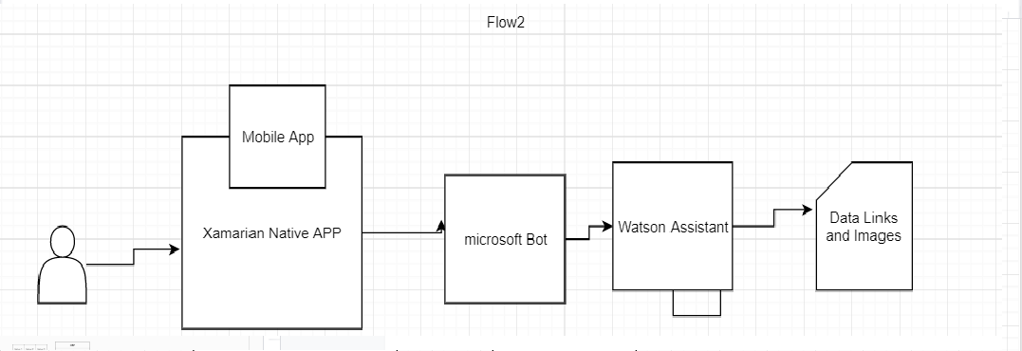
Future RoadMap
Add functionality in the app, for family and friends to stay in touch with their elderly or disabled young relatives as well as care personnel.
Share information such as text, photos and videos.

Slide 6
Thank You

